Slide 1

Unit-5 Key Management and Remote User Authentication
Information & Network Security (INS)
DU #2101CS622
Prof. Maulik D. Trivedi
Computer Engineering Department
maulik.trivedi@darshan.ac.in
9998 265 805

Slide 2

Looping
Outline
Key Management and Distribution
Symmetric Key Distribution using Symmetric and Asymmetric Encryptions
Distribution of Public Keys
X.509 Certificates
Public Key Infrastructure
Remote User Authentication with Symmetric and Asymmetric Encryption
Kerberos

Slide 3
Key Management and Distribution

Slide 4
Key Distribution
Key distribution is the function that delivers a key to two parties who wish to exchange secure encrypted data.
Some sort of mechanism or protocol is needed to provide the secure distribution of keys.
Key distribution often involves the use of
Master keys, which are infrequently used and are long lasting.
Session keys, which are generated and distributed for temporary use between two parties.

Slide 5
Symmetric Key Distribution using Symmetric and Asymmetric Encryptions

Slide 6

Symmetric Key Distribution using Symmetric Encryption
Objective: Two entities share same secret key.
Principle: Change keys frequently.
How to exchange a secret key?
For two parties A and B, key distribution can be achieved in a number of ways, as follows:
A can select a key and physically deliver it to B.
Third party can select the key and physically deliver it to A and B.
If A and B have previously and recently used a key, one party can transmit the new key to the other, encrypted using the old key.
If A and B each has an encrypted connection to a third party C, C can deliver a key on the encrypted links to A and B.

Slide 7
Using a Key Distribution Centre
Key Distribution Centre (KDC) is trusted third party.
Hierarchy of keys used:
Data sent between end-systems are encrypted with temporary session key.
Session keys obtained from KDC over network are encrypted with master key.
Master keys can be distributed using manual delivery.

Slide 8
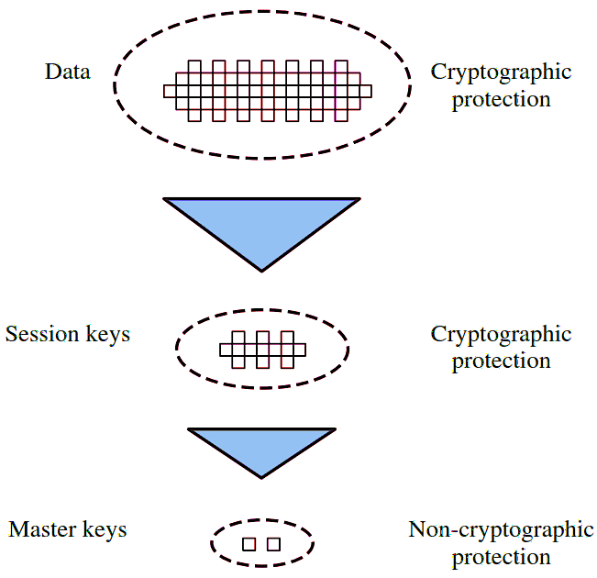
Key Hierarchy
Communication between end systems is encrypted using a temporary key, often referred to as a session key.
Session keys are transmitted in encrypted form, using a master key that is shared by the key distribution center and an end system or user.

Slide 9
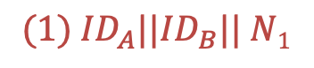
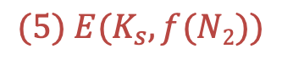
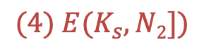
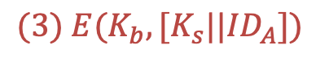
Key Distribution Scenario
Key Distribution Center (Key)
$$(1) {ID}_{A}||{ID}_{B}|| N1$$
$$(2) E(Ka, [K_{s} ||{ID}_{A}||{ID}_{B}|| N1]) || E(K_{b}, [K_{s}||{ID}_{A}])$$
$$(3) E(K_{b}, [K_{s}||{ID}_{A}])$$
Initiator
A
Initiator
B
$$(4) E(K_{s}, N2])$$
$$(5) E(K_{s}, f(N2))$$

Slide 10
KDC Scenario Notation
End-systems: A and B, identiﬁed by ID_{A} and ID_{B}.
Master keys: K_{a}, K_{b}
Session key (between A and B): K_{s}
Nonce values: N₁, N₂
E.g., timestamp, counter, random value.
Must be diﬀerent for each request.
Must be diﬃcult for an attacker to guess.

Slide 11

Key Distribution Scenario
A issues a requests to the KDC for a session key to protect logical connection to B. The message includes the identity of A and B and a unique nonce N₁.
The KDC responds with a message encrypted using K_{a} that includes:
One-time session key K_{s} to be used for the session.
The original request message to enable A to match response with appropriate request.
Information for B.
A stores the session key for use in the upcoming session and forwards to B the information from the KDC for B, namely, 𝐸(𝐾_{𝑏}, [ 𝐾_{𝑠} || 𝐼𝐷_{A} ]).
B sends a nonce N₂ to A using the new session key.
A responds with f(N₂) using K_{s}.
Last two steps assure B, that, the original message it received (step 3) was not a replay.
$${ID}_{A}\left|\left|{ID}_{B}\right|\right|N$$

Slide 12
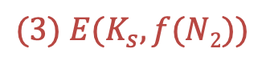
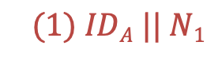
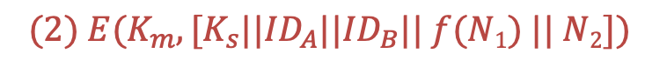
Decentralised Key Distribution
Alternative option that doesn’t rely on KDC.
Each end-system must manually exchange n−1 master keys (K_{m}) with others.
A issues a request to B for a session key and includes a nonce.
B responds with a message that is encrypted using the shared master key.
A returns f(N₂) to B using the new session key.
$$(1) IDA || N1$$
Initiator
A
Initiator
B
$$(2) E(K_{m}, [K_{s}||{ID}_{A}||{ID}_{B}|| f(N1) || N2])$$
$$(3) E(K_{s},f(N2))$$

Slide 13
Symmetric Key Distribution using Asymmetric Encryption
Common application of asymmetric encryption is exchanging secret keys.
Two examples:
Simple Secret Key Distribution.
Secret Key Distribution with Conﬁdentiality and Authentication.

Slide 14
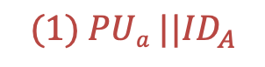
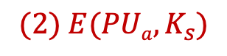
Simple Secret Key Distribution
A generates a public/private key pair {PU_{a}, PR_{a}} and transmits a message to B consisting of PU_{a} and an identifier of A, ID_{A}.
B generates a secret key, K_{s} and transmits it to A, encrypted with A's public key.
A computes D(PR_{a}, E(PU_{a}, K_{s})) to recover the secret key. Only A can decrypt the message because only A and B will know the identity of K_{s}.
A discards PU_{a} and PR_{a} and B discards PU_{a}.
$$(1) PUa ||{ID}_{A}$$
Initiator
A
Initiator
B
$$(2) E(PUa,K_{s})$$

Slide 15
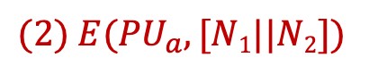
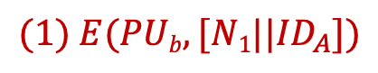
Secret Key Distribution with Confidentiality & Authentication
$$(1) E(PUb,[N1||{ID}_{A}])$$
A uses B's public key to encrypt a message to B containing an identifier of A(ID_{A}) and a nonce (N₁), which is used to identify this transaction uniquely.
B sends a message to A encrypted with PU_{a} and containing A's (N₁) as well as a new nonce generated by B(N₂). The presence of N₁ in message (2) assures A that the correspondent is B.
$$(2) E({PU}_{a},[N1||N2])$$
Initiator
A
Initiator
B

Slide 16
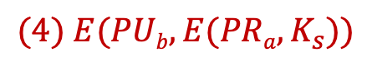

Secret Key Distribution with Confidentiality & Authentication
$$(1) E(PUb,[N1||{ID}_{A}])$$
A returns N₂, encrypted using B's public key, to assure B that its correspondent is A.
A selects a secret key K_{s} and sends M = E(PU_{b}, E(PR_{a}, K_{s})) to B. Encryption with B's public key ensures that only B can read it; encryption with A's private key ensures that only A could have sent it.
B computes D(PU_{a},D(PR_{b},M)) to recover the secret key.
$$(2) E({PU}_{a},[N1||N2])$$
Initiator
A
Initiator
B
$$(3) E({PU}_{b},N2])$$
D(PU_{a},D(PR_{b},M))
$$(4) E(PUb,E(PRa,K_{s}))$$

Slide 17
Distribution of Public Keys

Slide 18
Distribution of Public Keys
Public keys are made public by design.
Issue: how to ensure public key of A actually belongs to A (and not someone pretending to be A).
Four approaches for distributing public keys
Public announcement
Publicly available directory
Public-key authority
Public-key certificates

Slide 19
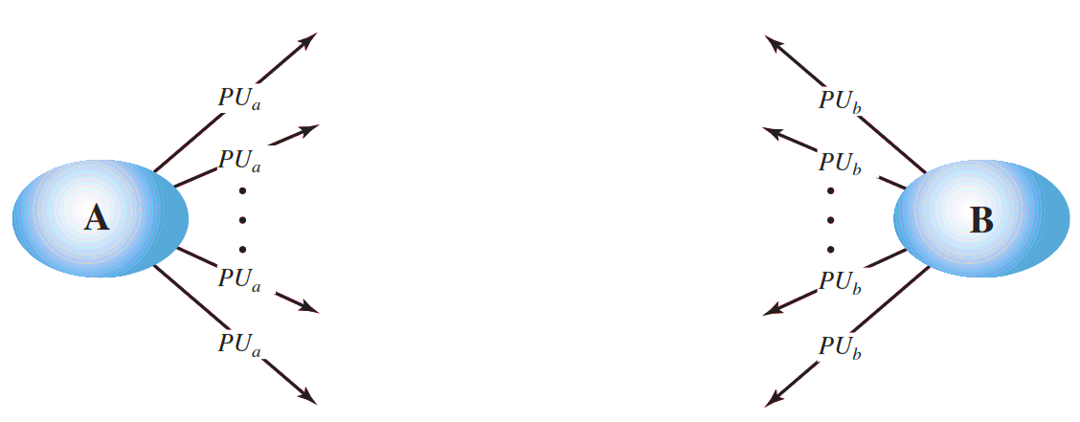
1. Public Announcement
Make public key available in open forum: newspaper, email signature, website and conference.
Problem: anyone can announce a key pretending to be another user.

Slide 20
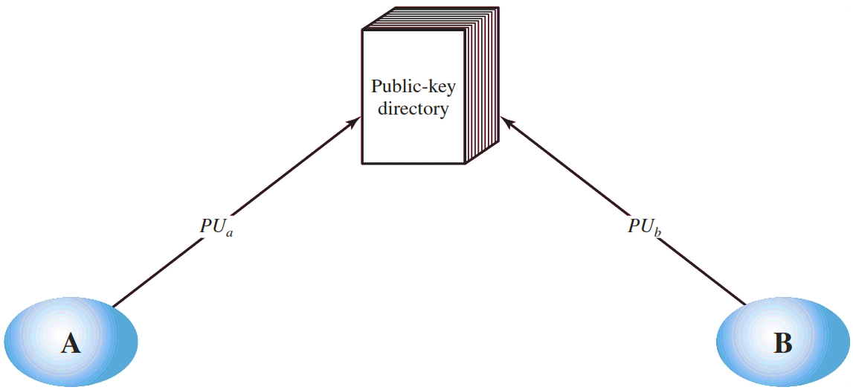
2. Publicly Available Directory
The authority maintains a directory with a {name, public key} entry for each participant.
Each participant registers a public key with the directory authority.
A participant may replace the existing key with a new one at any time.
Participants could also access the directory electronically.
For this purpose, secure, authenticated communication from the authority to the participant is mandatory.

Slide 21
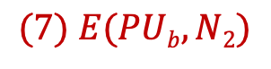
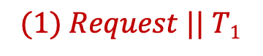
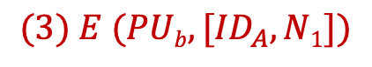
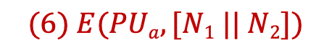
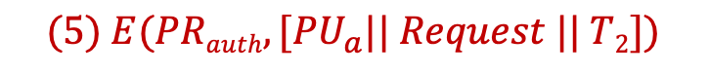
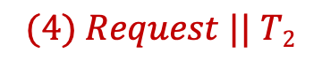
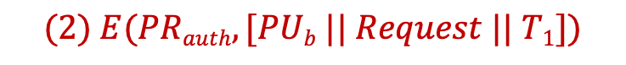
3. Public-Key Authority
A sends a timestamped message to the public-key authority containing a request for the current public key of B.
Public-Key Authority
$$(1) Request || T1$$
The authority responds with a message that is encrypted using the authority’s private key. Message contains PU_{b}, Original request and Original time stamp T_{1.}
$$(4) Request || T2$$
$$(2) E(PRauth, [PUb || Request || T1])$$
$$(5) E(PRauth, [{PU}_{a}|| Request || T2])$$
A stores B’s public key and also uses it to encrypt a message to B containing an identifier of A(ID_{a}) and a nonce(N₁).
$$(3) E (PUb, [{ID}_{A}, N1])$$
Initiator
A
Initiator
B
B retrieves A’s public key from the authority in the same manner as A retrieved B’s public key.
$$(6) E(PUa, [N1 || N2])$$
$$(7) E(PUb, N2)$$

Slide 22
3. Public-Key Authority – Cont…
A sends a timestamped message to the public-key authority containing a request for the current public key of B.
The authority responds with a message that is encrypted using the authority’s private key. Message contains PU_{b}, Original request and Original time stamp T_{1.}
A stores B’s public key and also uses it to encrypt a message to B containing an identifier of A(ID_{a}) and a nonce(N₁).
4, 5. B retrieves A’s public key from the authority in the same manner as A retrieved B’s public key.

Slide 23
3. Public-Key Authority – Cont…
B sends a message to A encrypted with PU_{a} and containing A’s nonce(N₁) as well as a new nonce generated by B(N₂). The presence of N₁ in message (6) assures A that the correspondent is B.
A returns N₂, which is encrypted using B’s public key, to assure B that its correspondent is A.

Slide 24
4. Public-Key Certificates
Any participant can read a certificate to determine the name and public key of the certificate’s owner.
Any participant can verify that the certificate originated from the certificate authority and is not counterfeit.
Only the certificate authority can create and update certificates.
Any participant can verify the currency of the certificate.

Slide 25






4. Public-Key Certificates – Cont.
Certificate
Authority
$$PUa$$
$$PUb$$
$$CA = E({PR}_{auth}, [T1 || IDa ||PUa])$$
$$CA = E({PR}_{auth}, [T2 || IDb || PUb])$$
$$(1) CA$$
Initiator
A
Initiator
B
$$(2) CA$$

Slide 26
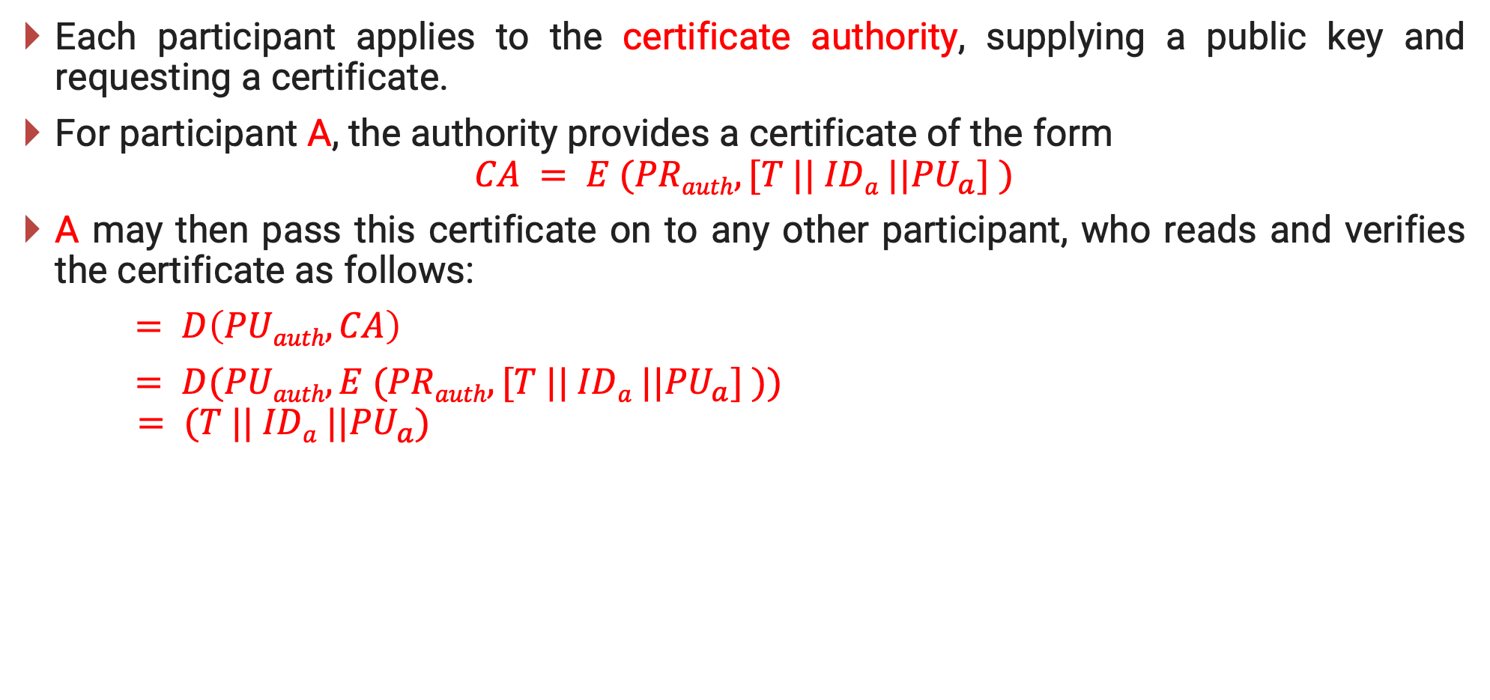
4. Public-Key Certificates – Cont…
Each participant applies to the certificate authority, supplying a public key and requesting a certificate.
For participant A, the authority provides a certificate of the form
$$CA = E (PRauth, [T || IDa ||{PU}_{a}] )$$
A may then pass this certificate on to any other participant, who reads and verifies the certificate as follows:
$= D\left(PUauth, CA\right)$
$= D(PUauth, E (PRauth, [T || IDa ||{PU}_{a}] ))$
$$= (T || IDa ||{PU}_{a})$$

Slide 27
X.509 Certificates

Slide 28
X.509 Certificates
An X.509 certificate is a digital certificate that uses the widely accepted international X.509 public key infrastructure (PKI) standard to verify that a public key belongs to the user, computer or service identity contained within the certificate.
X.509 defines the format for public-key certificates used in a variety of applications.
The directory may serve as a repository of public-key certificates.
Each certificate contains the public key of a user and is signed with the private key of a trusted certification authority.

Slide 29
Version
X.509 Formats
Certificate
serial number
Signature
algorithm
identifier
Algorithm
Parameters
Version 1
Issuer name
Proof of validity
Not before
Not after
Version 2
Version 3
Subject name
Subject’s public key info
Algorithms
Parameters
Key
Issuer Unique identifier
Subject Unique identifier
Extensions
All
Versions
Algorithms
Parameters
Encrypted hash
Signature

Slide 30
X.509 Format – Cont…
Version: Differentiates among successive versions of the certificate format; the default is version 1.
Serial number: The identity creating the certificate must assign it a serial number that distinguishes it from other certificates.
Signature algorithm identifier: The algorithm used by the issuer to sign the certificate.
Issuer name: The name of the entity issuing the certificate (usually a certificate authority).
Period of validity: Consists of two dates: the first and last on which the certificate is valid.
Subject name: The name of the user to whom this certificate refers.

Slide 31
X.509 Format – Cont…
Subject’s public-key information: The public key associated with the identity.
Issuer unique identifier: An optional-bit string field used to identify uniquely the issuing Certificate Authority (CA).
Subject unique identifier: An optional-bit string field used to identify uniquely the subject name.
Extensions: A set of one or more extension fields.

Slide 32
Public Key Infrastructure

Slide 33

Public-Key Certificate Use
Bob’s ID information
Unsigned certificate:
contains user ID,
user's public key
Bob’s Public key
H
H
CA
information
Recipient can verify
signature by comparing
hash code values
E
D
Generate hash
code of unsigned
certificate
Signed Certificate
Encrypt hash code
with CA's private key
to form signature
Decrypt signature
with CA's public key
to recover hash code

Slide 34
Public key Infrastructure (PKI)
A public-key infrastructure (PKI) is defined as the set of hardware, software, people, policies, and procedures needed to create, manage, store, distribute, and revoke digital certificates based on asymmetric cryptography.
It provides the identification of public keys and their distribution.
The principal objective for developing a PKI is to enable secure, convenient, and efficient acquisition of public keys.

Slide 35
Public key Infrastructure (PKI)
PKI users
Certificate/CRL retrieval
End entity
Registration,
Initialization,
Certification,
Key pair recovery,
Key pair update, Revocation request
Certificate/CRL Repositories
Registration
authority
Certificate
publication
Certificate
authority
Certificate/CRL publication
Cross
certification
CRL Issuer
CRL publication
Certificate
authority
PKI management
entities

Slide 36
Public key Infrastructure (PKI) – Cont…
End entity: A generic term used to denote end users, devices (e.g., servers, routers), or any other entity that can be identified in the subject field of a public-key certificate.
Certification authority (CA): The issuer of certificates and certificate revocation lists (CRLs).
Registration authority (RA): CA may use a third-party Registration Authority (RA) to perform the necessary checks on the person or company requesting the certificate to confirm their identity.
CRL issuer: An optional component that a CA can delegate to publish CRLs.
Repository: A generic term used to denote any method for storing certificates and CRLs so that they can be retrieved by end entities.

Slide 37
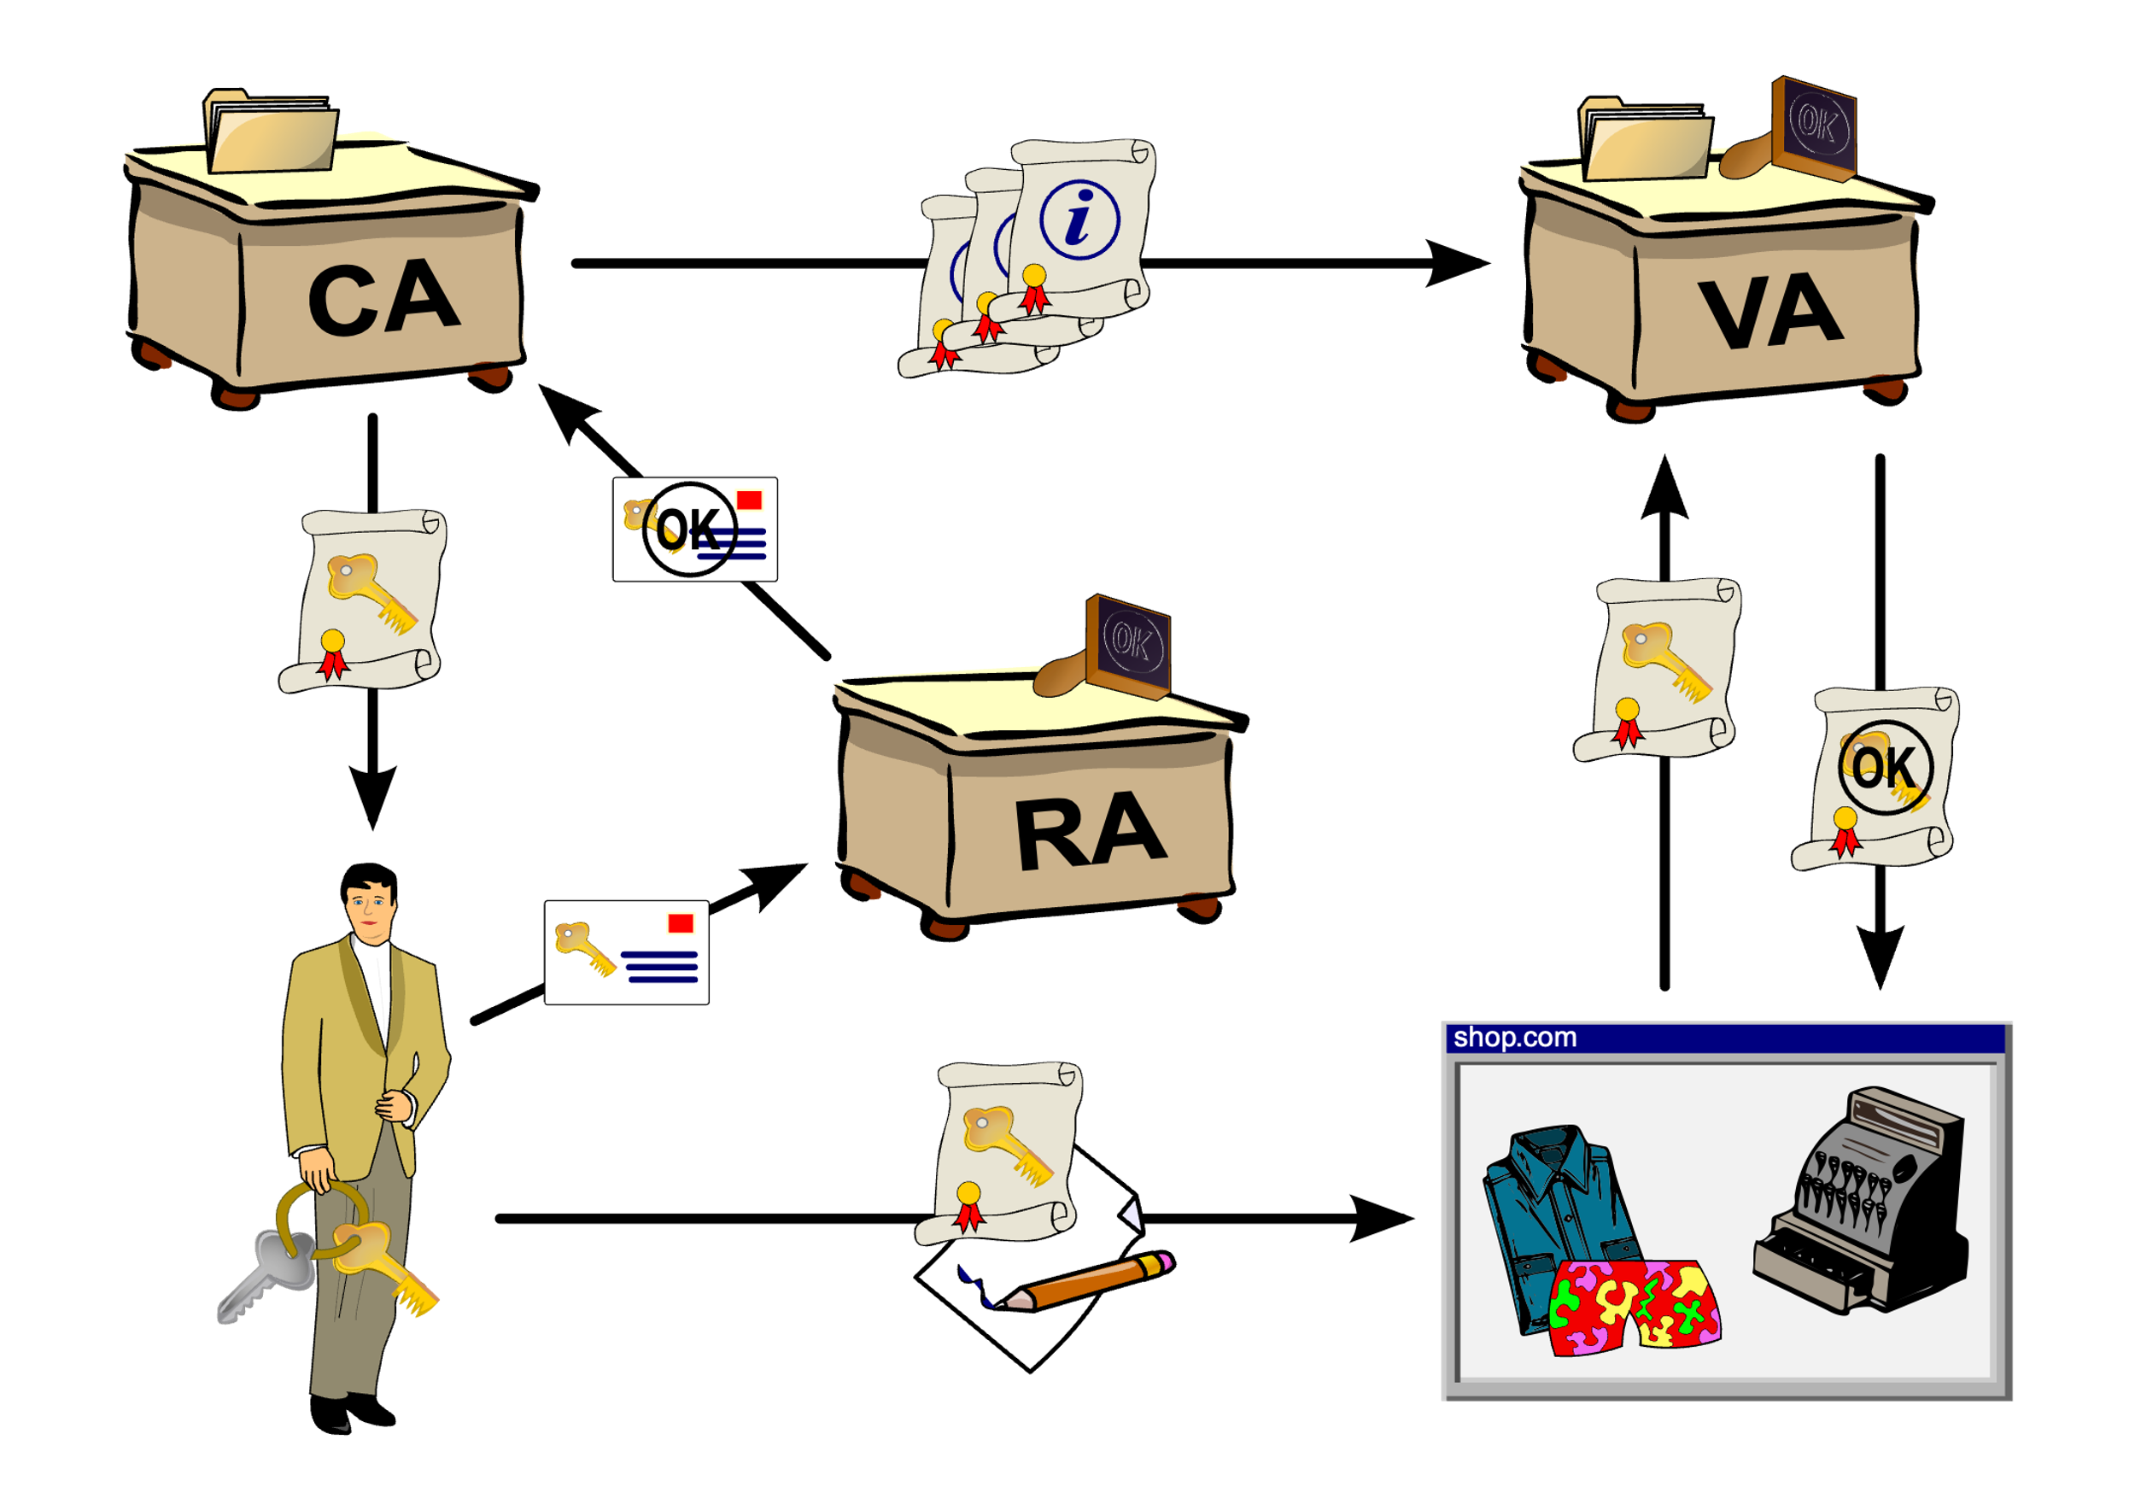
Working of PKI - Example

Slide 38
Remote User Authentication with Symmetric and Asymmetric Encryption

Slide 39
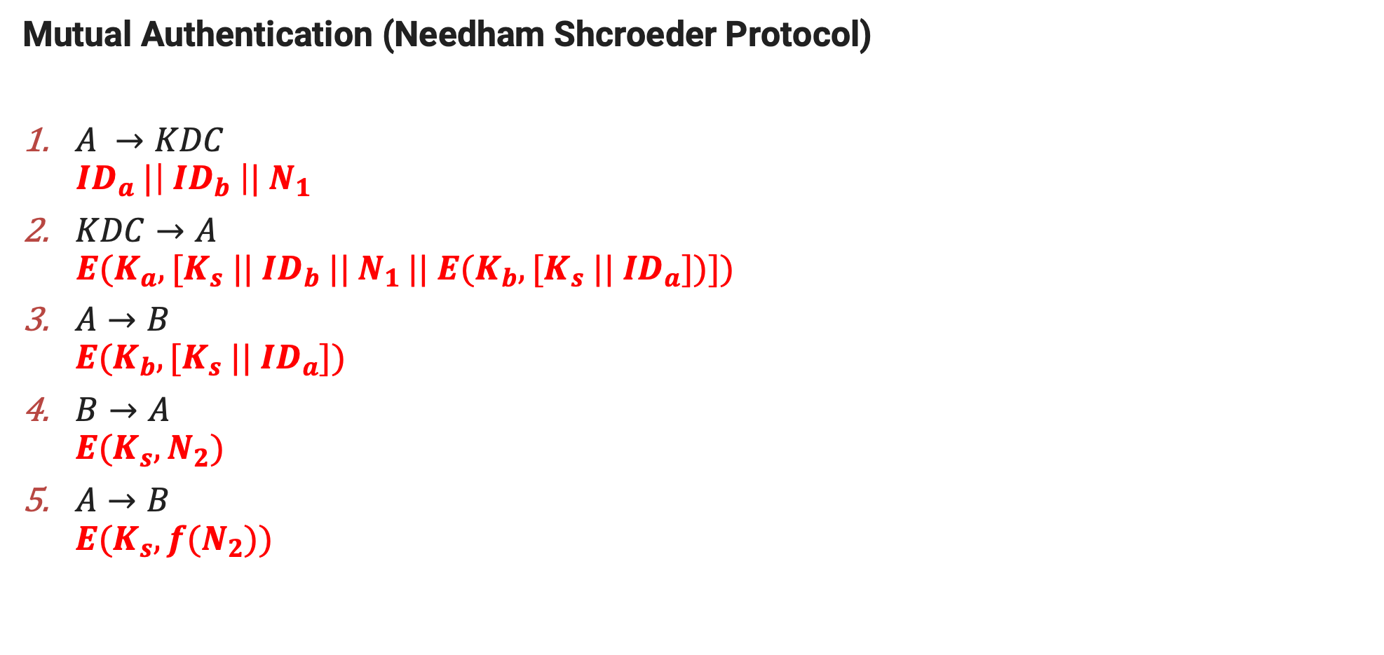
Remote user authentication with symmetric encryption
Mutual Authentication (Needham Shcroeder Protocol)
$A →KDC$
$${ ID}_{a} |\left|{ ID}_{b} \right||{ N}_{1}$$
$KDC→A$
$$E(K_{a}, [K_{s} {||{ ID}_{b} || N}_{1 }|| E(K_{b}, [K_{s} ||{ ID}_{a}])])$$
$A→B$
$$E(K_{b}, [K_{s} ||{ ID}_{a}])$$
$B→A$
$$E(K_{s},N_{2})$$
$A→B$
$$E(K_{s},{f(N}_{2}))$$

Slide 40
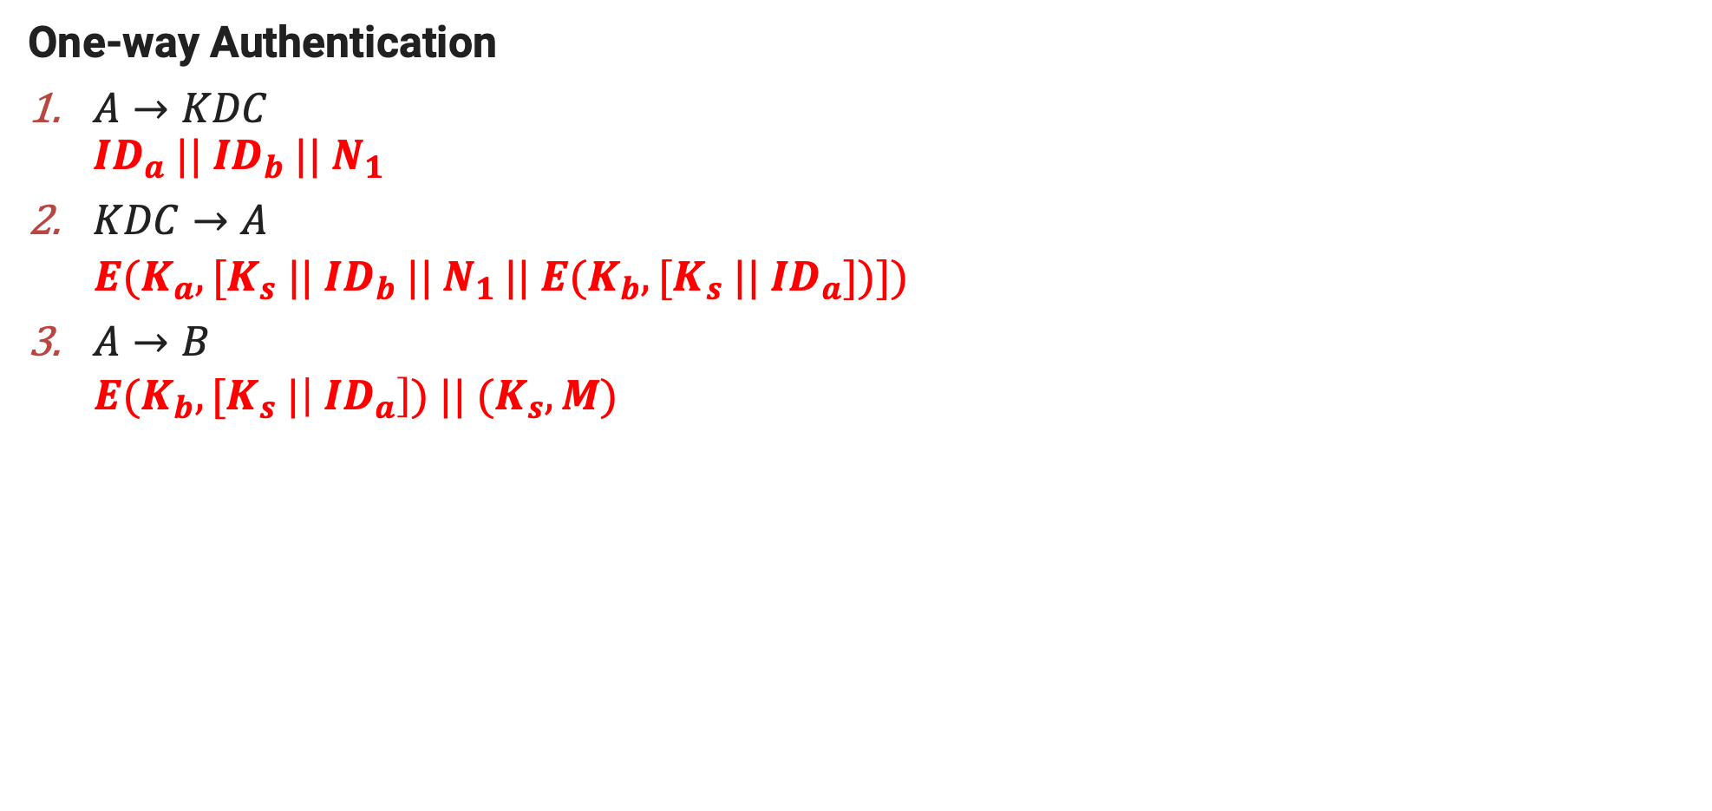
Remote user authentication with symmetric encryption
One-way Authentication
$A→KDC$
$${ID}_{a} || {ID}_{b} ||{ N}_{1}$$
$KDC→$ $A$
$E(K_{a}, [K_{s} {||{ ID}_{b} || N}_{1 }|| E(K_{b}, [K_{s} ||{ ID}_{a}])])$
$A→B$
$E(K_{b}, [K_{s} |\left|{ ID}_{a}\right]) || (K_{s},M)$

Slide 41
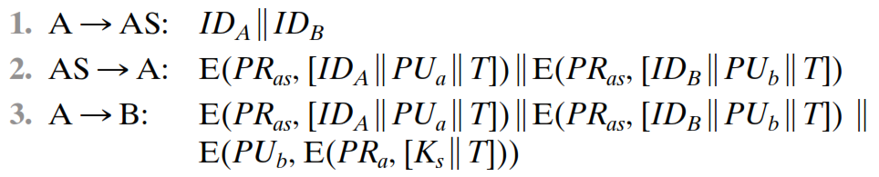
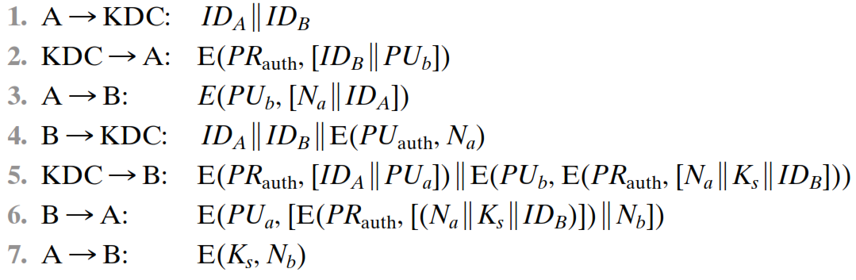
Remote user authentication with Asymmetric encryption
Mutual Authentication

Slide 42
Kerberos

Slide 43

Kerberos
Kerberos provides a trusted third-party authentication service that enables clients and servers to establish authenticated communication.
Kerberos is an authentication service designed for use in a distributed environment.
Version 4 of Kerberos makes use of DES, to provide the authentication service.
In Greek mythology, Kerberos (or Cerberus) is a multi-headed dog that guards the entrance to the underworld.

Slide 44


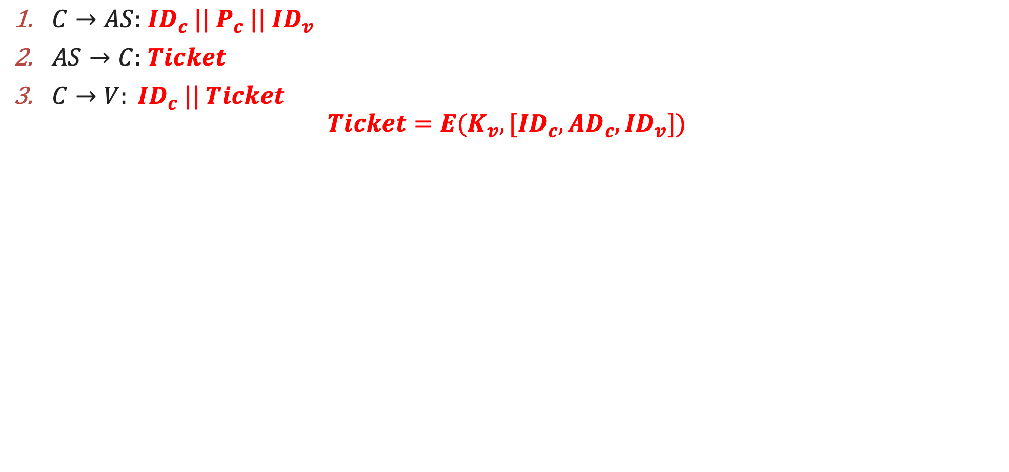
Kerberos – Simple Dialogue
$C→AS:$ ${ID}_{c} || P_{c}{ || ID}_{v}$
$AS→C:$ $Ticket$
$C→V: {ID}_{c} || Ticket$
$$Ticket=E(K_{v}, [{ID}_{c},{AD}_{c},{ID}_{v}])$$
(1)
(2)
Authentication Server-AS
User - C
(3)
Application Server - V

Slide 45
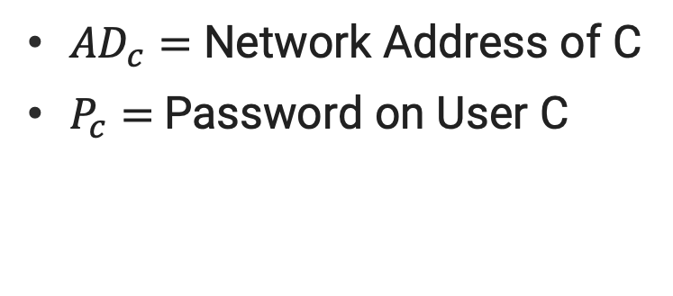
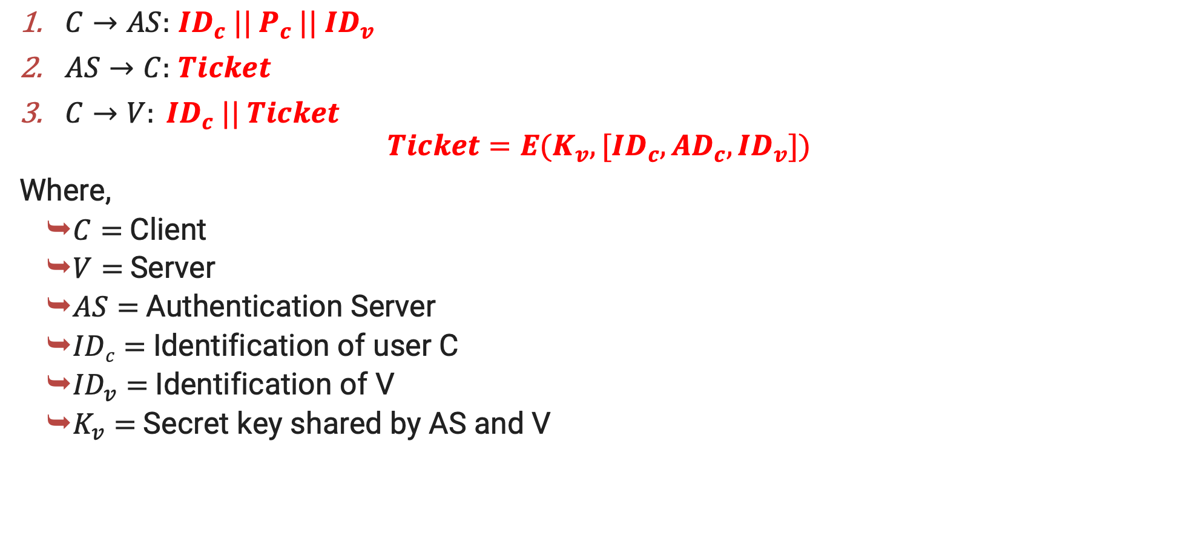
Kerberos – Simple Dialogue
$C→AS:$ ${ID}_{c} || P_{c}{ || ID}_{v}$
$AS→C:$ $Ticket$
$C→V: {ID}_{c} || Ticket$
$$Ticket=E(K_{v}, [{ID}_{c},{AD}_{c},{ID}_{v}])$$
Where,
$C=$Client
$V=$Server
$AS=$Authentication Server
$IDc=$Identification of user C
${ID}_{v}=$Identification of V
$K_{v}=$Secret key shared by AS and V
${AD}_{c}=$ Network Address of C
$P_{c}=$Password on User C

Slide 46
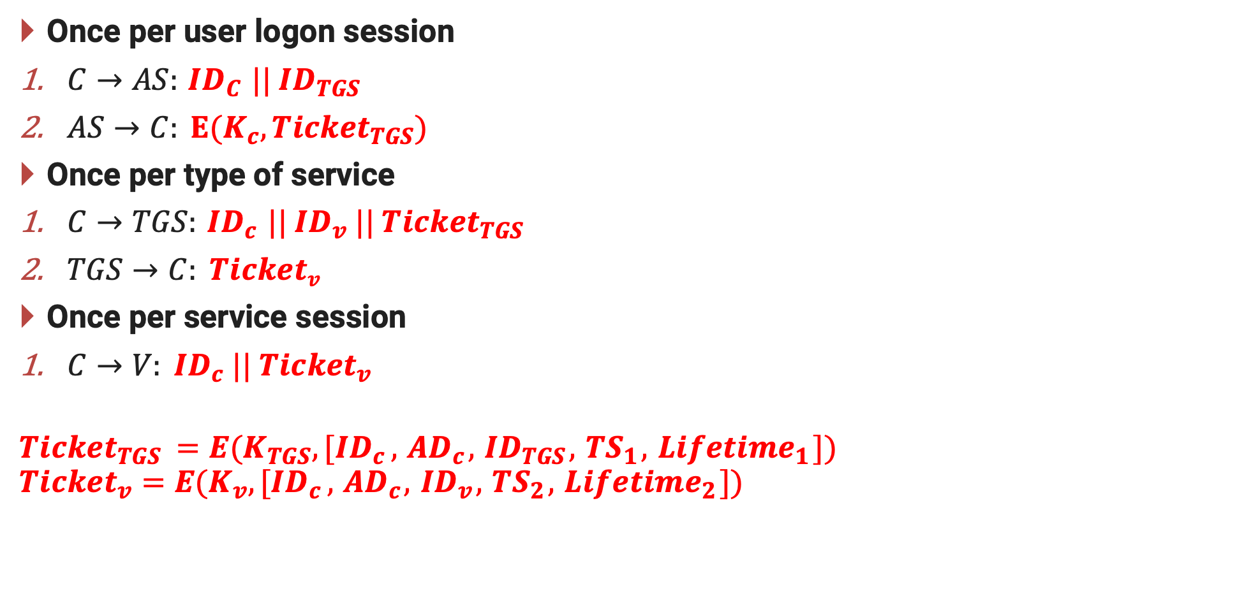
Kerberos – More Secure Dialogue
Once per user logon session
$C→AS:{ ID}_{C} || {ID}_{TGS}$
$AS→C: E(K_{c}, {Ticket}_{TGS})$
Once per type of service
$C→TGS:{ ID}_{c} || {ID}_{v} || {Ticket}_{TGS}$
$TGS→C: Ticketv$
Once per service session
$C→V: {ID}_{c} || {Ticket}_{v}$
$${Ticket}_{TGS }=E(K_{TGS}{,[ID}_{c}, { AD}_{c}, { ID}_{TGS},{ TS}_{1},{ Lifetime}_{1}])$$
$${Ticket}_{v}=E(K_{v}{,[ID}_{c}, { AD}_{c}, { ID}_{v},{ TS}_{2},{ Lifetime}_{2}])$$

Slide 47


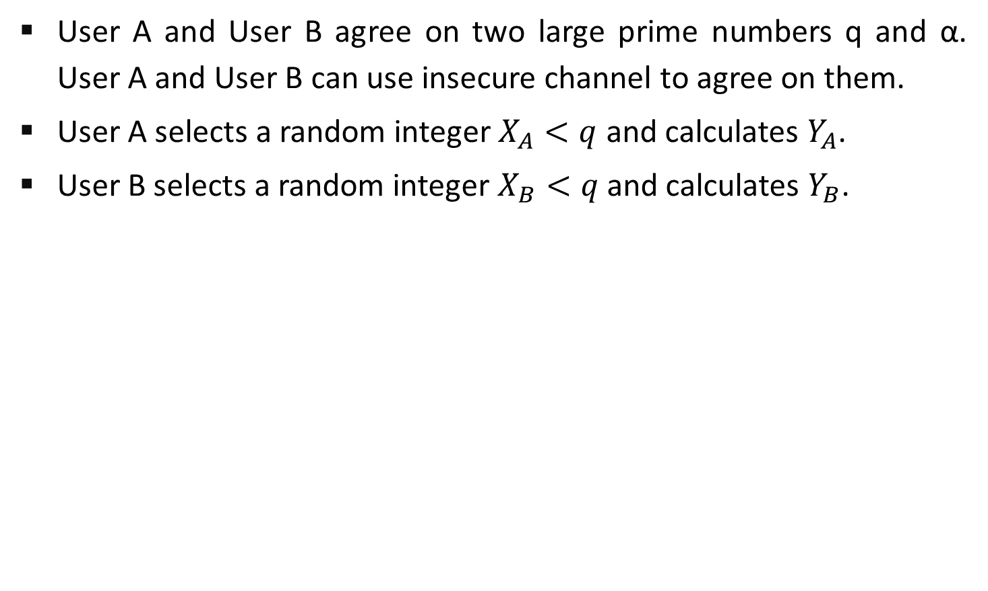

Kerberos – More Secure Dialogue
Request for ${Ticket}_{TGS}$
Authentication Server-AS
${Ticket}_{TGS}$ to access TGS
Request for Service
Client-C
Server
Request for ${Ticket}_{v}$
${Ticket}_{v}$ to access Server
Ticket Granting Server-TGS

Slide 48
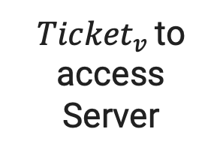
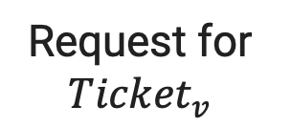
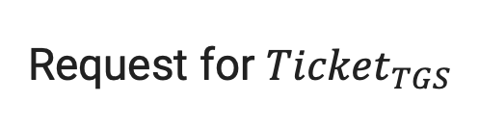
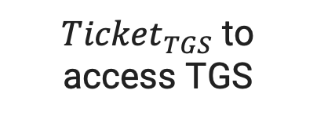
Kerberos – More Secure Dialogue
Request for ${Ticket}_{TGS}$
${Ticket}_{TGS}$ to access TGS
Authentication Server-AS
Request for ${Ticket}_{v}$
Client-C
${Ticket}_{v}$ to access Server
Ticket Granting Server-TGS
Request for Service
Server

Slide 49
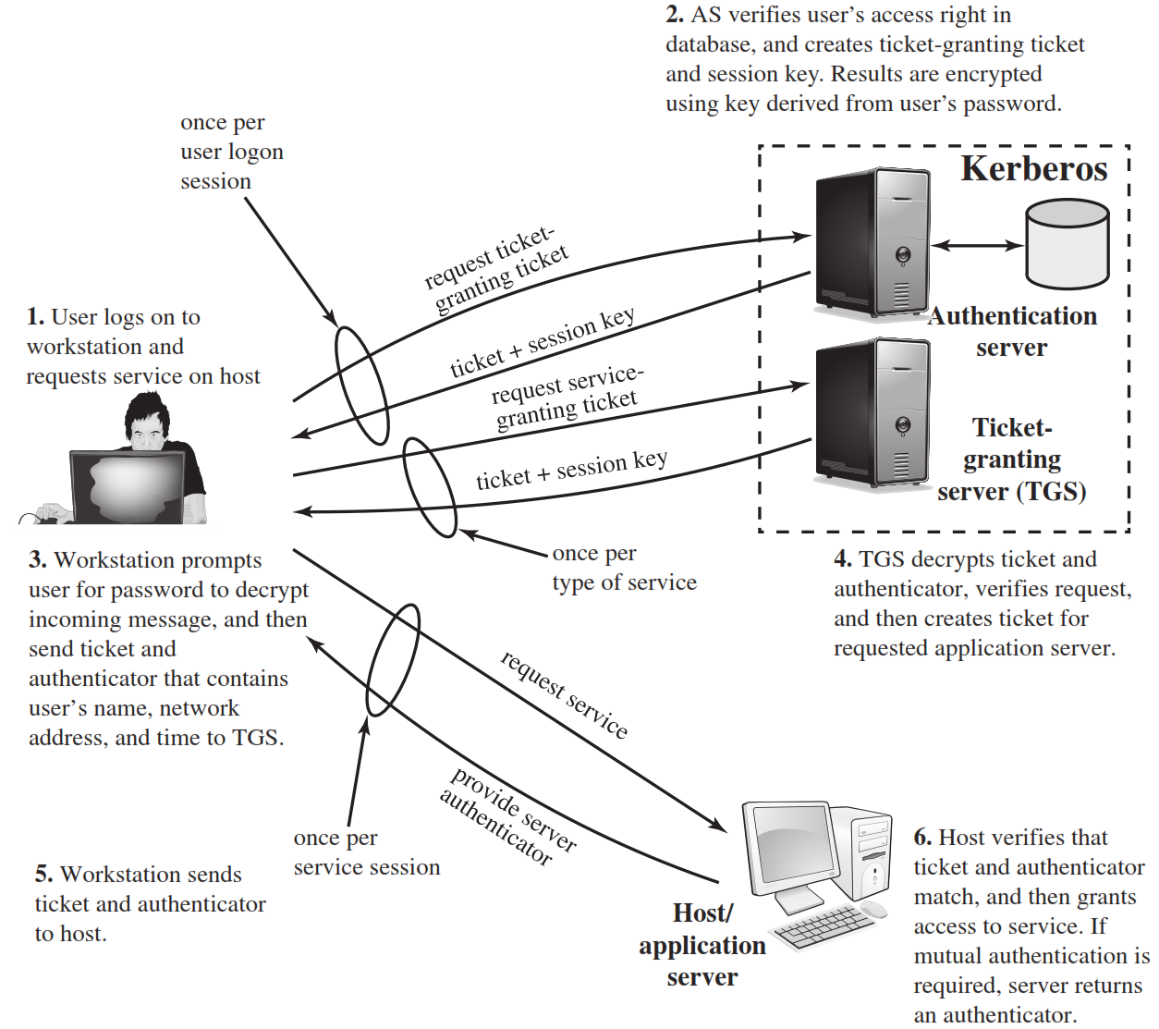

Slide 50
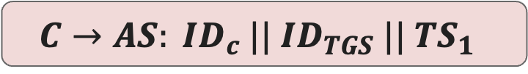
Kerberos Version 4 – Step-1
The client sends a plaintext request to the AS asking for a ticket it can use to talk to the TGS.
Request:
Login name
TGS name
Since this request contains only well-known names, it does not need to be sealed.
$$C→AS: {ID}_{c} || {ID}_{TGS}{ || TS}_{1}$$

Slide 51
Kerberos Version 4 – Step-2
The AS finds the keys corresponding to the login name and the TGS name.
The AS creates a ticket:
Login name
TGS name
Client network address
TGS session key
The AS seals the ticket with the TGS secret key.
$$AS→C: E(K_{c},[{ K}_{c,TGS} || {ID}_{TGS }|\left|{ TS}_{2 }\right||{ Lifetime}_{2 }||{ Ticket}_{TGS} ])$$
$${ Ticket}_{TGS}=E(K_{TGS},[{ K}_{c,TGS} || {ID}_{c }||{ AD}_{c }|\left|{ ID}_{TGS }||{ TS}_{2 }\right||{ Lifetime}_{2}])$$

Slide 52
Kerberos Version 4 – Step-3
The client decrypts the message using the user’s password as the secret key.
The client now has a session key and ticket that can be used to contact the TGS.
The client cannot see inside the ticket, since the client does not know the TGS secret key.
When a client wants to start using a server (service), the client must first obtain a ticket.
The client composes a request to send to the TGS.
$$C→TGS: {ID}_{v} ||{ Ticket}_{TGS} ||{ Authenticator}_{c}$$

Slide 53
Kerberos Version 4 – Step-4
The TGS decrypts the ticket using it’s secret key.
The TGS decrypts the authenticator using the session key.
The TGS checks all the incoming information to make sure that login names, client addresses and TGS server name are all ok.
TGS makes sure the authenticator is recent.
Builds a ticket for the client and requested server. The ticket is sealed with the server key.
Creates a session key.
Seals the entire message with the TGS session key and sends it to the client.
$$TGS→C:E(K_{c,TGS}, [K_{c,v} || {ID}_{v}{ || TS}_{4 }||{ Ticket}_{v}])$$

Slide 54
Kerberos Version 4 – Step-4
$${ Ticket}_{TGS}=E(K_{TGS},[{ K}_{c,TGS} || {ID}_{c }||{ AD}_{c }|\left|{ ID}_{TGS }||{ TS}_{2 }\right||{ Lifetime}_{2}])$$
$${ Ticket}_{v}=E(K_{v},[{ K}_{c,v} || {ID}_{c }||{ AD}_{c }|\left|{ ID}_{v }||{ TS}_{4 }\right||{ Lifetime}_{4}])$$
$${Authenticator}_{c}=E(K_{c,TGS},[ {ID}_{c }||{ AD}_{c} || {TS}_{3 }])$$

Slide 55
Kerberos Version 4 – Step-5,6
The client now decrypts the TGS response using the TGS session key.
The client now has a session key for use with the new server, and a ticket to use with that server.
The client can contact the new server using the same format used to access the TGS.
$$C→V:{ Ticket}_{v} ||{Authenticator}_{c})$$
$V→C:E\left(K_{c,v},\left[{TS}_{5}+1\right]\right)$(for mutual Authentication)

Slide 56
Kerberos Version 4 – Step-5,6
$${ Ticket}_{v}=E(K_{v},[{ K}_{c,v} || {ID}_{c }||{ AD}_{c }|\left|{ ID}_{v }||{ TS}_{4 }\right||{ Lifetime}_{4}])$$
$${Authenticator}_{c}=E(K_{c,v},[ {ID}_{c }||{ AD}_{c} || {TS}_{5 }])$$

Slide 57
Ticket
Each request for a service requires a ticket.
A ticket provides a single client with access to a single server.
Tickets are dispensed by the “ticket granting server” (TGS), which has knowledge of all the encryption keys.
Tickets are meaningless to clients, they simply use them to gain access to servers.
The TGS seals (encrypts) each ticket with the secret encryption key of the server.
Sealed tickets can be sent safely over a network - only the server can make sense out of it.
Each ticket has a limited lifetime (a few hours).

Slide 58
Ticket Contents
Client name (user login name)
Server name
Client host network address
Session key for client/server
Ticket lifetime
Creation timestamp

Slide 60
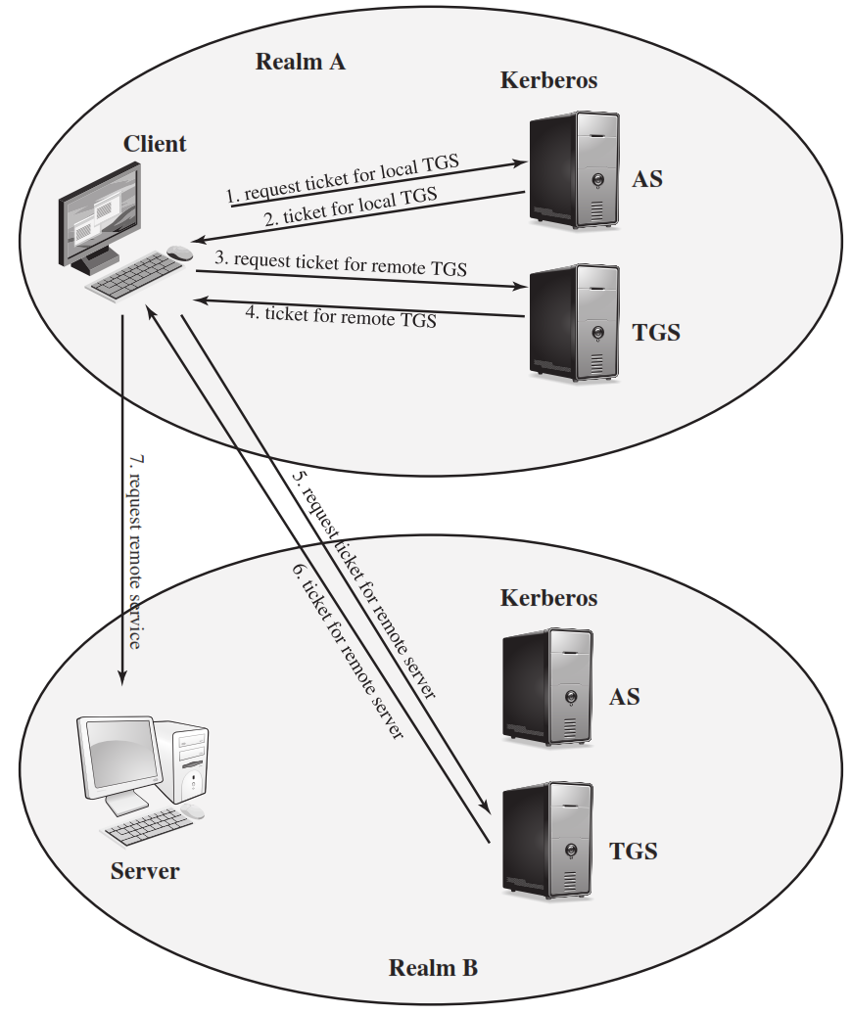
Kerberos Realm

Slide 61
Kerberos Realm
Kerberos
Realm A
AS
1. Request ticket for local TGS
2. Ticket for local TGS
User - C
3. Request ticket for remote TGS
4. Ticket for remote TGS
TGS
7. Request remote service
6. Ticket for remote server
5. Request ticket for remote server
AS
Server
TGS
Realm B

Slide 62
Information & Network Security (INS)
DU #2101CS622
Prof. Maulik D Trivedi
Computer Engineering Department
maulik.trivedi@darshan.ac.in
9998 265 805

